Slide 1

NATURAL LANGUAGE PEOCESSING PROJECT
Team Members
Nethaji Achha (19K41A0432)
Vamshi Yadav (19K41A0510)
Manugonda Ganesh (19K41A0516)
Supervisor
Mr. D. Ramesh
Assistant Professor of CSE

Slide 2
Title: Automated Essay Scoring (AES)
Introduction
project objectives
literature survey
Project Beneficiaries
Agenda
dataset insight
methodology
model architecture
data flow
application

Slide 3

Introduction
Automated Essay Scoring (AES) is a tool for evaluating and scoring of essays written
The process of automating the assessment process could be useful for both educators and learners

Slide 4
Project objectives
The project aims to develop an automated essay assessment system by use Artificial Intelligence by classifying the essays and grading them based on the performance automatically.
•The main objective of our project is to create deep learning model for Automated essay scoring (AES).
•It is a computer-based assessment system that automatically scores or grades the student responses by considering appropriate features. By using BERT and KMEANS clustering we develop the model
•Its objective is to classify a large set of textual entities into a small number of discrete categories, corresponding to the possible grades, for example, the numbers 1 to 6.

Slide 5



Project beneficiaries
Students
Faculty
Any Test conductors

Slide 6
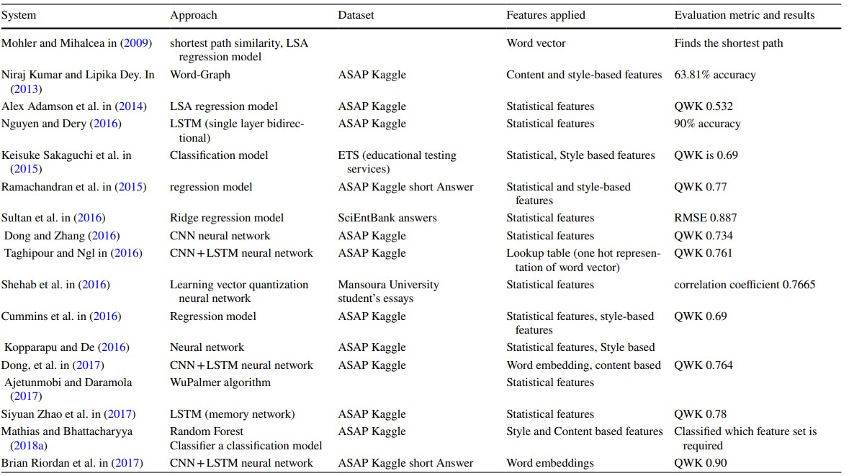
Literature Survey

Slide 7
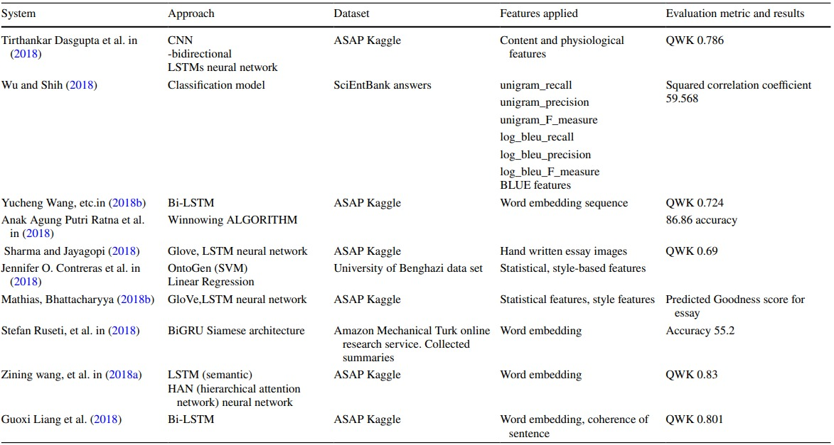

Slide 8
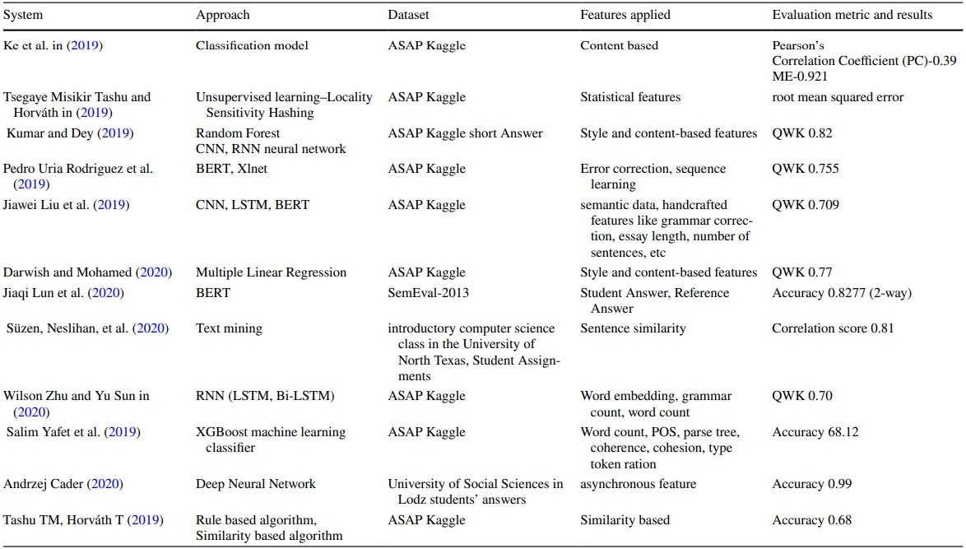

Slide 9
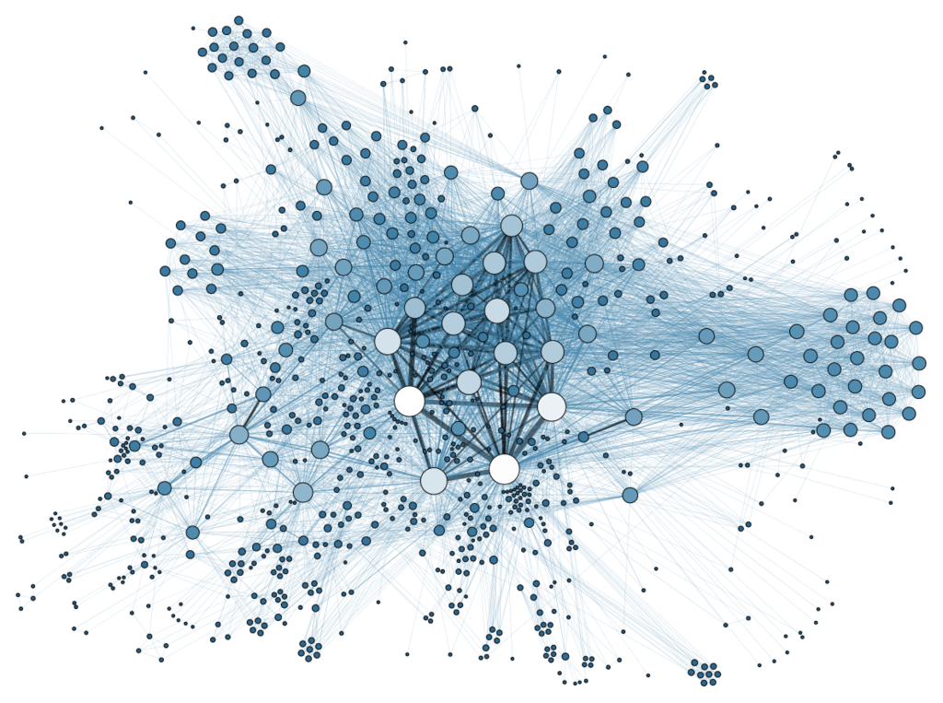
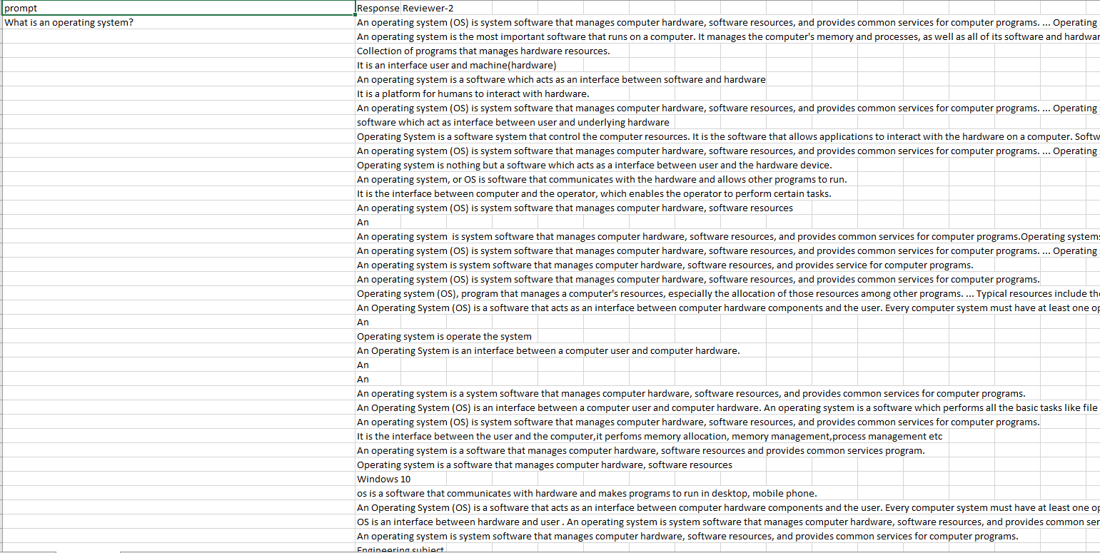
Dataset Insights
• For Automated essay grading we need dataset. The dataset to work on and we decided to use the BERT Model. Create a model that will help us to estimate of score for given essay .
We had 270 different essays of single topics

Slide 10
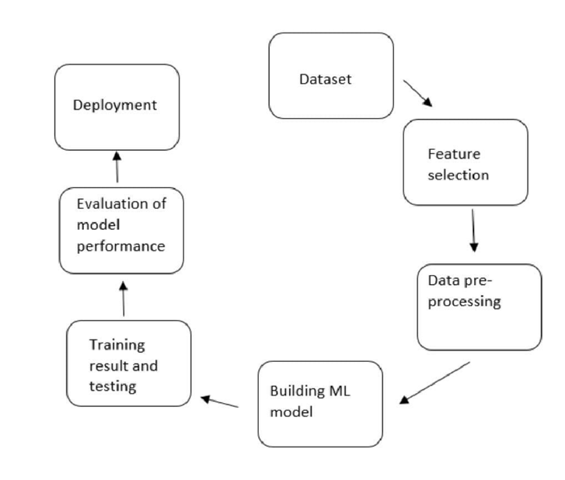
Methodology

Slide 11
Transfer-Learning:
For natural language processing, the transformers architecture is thego-tomodel for solving different problems,
e.g. text classification, machine translation, language modeling, text generation, question answering, etc. Thanks to Huggingfaceand its ecosy
Transfer learning is mostly used in computer vision and natural language processing tasks like sentiment analysis due to the huge amount of computational power required.

Slide 12
KMEANS CLUSTRING
Clustering is one of the most common exploratory data analysis technique used.
we try to find homogeneous subgroups within the data such that data points in each cluster are as similar as possible according to a similarity measure such as euclidean-based distance or correlation-based distance.

Slide 13
CONCLUSION
The previous or existing automated essay grading systems used traditional text based machine learning models. The results highly rely on the crafted extracted features. The performances are unstable when grading different essays from various topics.

Slide 14
THANK YOU

